Slide 1


SEVA FIRST INNOVATION CHALLENGE 2026
TITLE PAGE
Problem Statement ID – [PS ID]
Problem Statement Title- [PS Title]
Theme- Surakshit Bharat (Theme 5)
PS Category- Software
Team ID- [Team ID]
Team Name (Registered on portal) - [Team Name]

Slide 2
RAKSHA-PATH X
[Team Name]
Proof-of-Passability Emergency Intelligence Network · “Every route needs evidence. Every rescue needs a safer path.”
Proposed Solution (Describe your Idea/Solution/Prototype)
❖ Detailed explanation of the proposed solution
Every road gets an evidence-based status
A decision-support platform for emergency control rooms that rates every road segment by the evidence behind it: recency, source trust, verification
Evidence-aware routing for ambulances, fire tenders and rescue units, with alternatives, vehicle restrictions and field-verification tasks
Verified passable
Recent evidence from an authenticated or verified source
Potential hazard
Hazard reported, not yet verified
❖ How it addresses the problem
Navigation apps assume roads are open. In floods and landslides they are not, and the cost is lost rescue time
Never routes through a confirmed block; when no adequately verified route exists it says so and proposes the nearest reachable meeting point
Blocked
Confirmed; never used for routing
Unknown
No adequate evidence (no report is not 'open')
❖ Innovation and uniqueness of the solution
Proof-of-Passability: evidence expires per hazard type (flood 2 h, fallen tree 12 h); “no report” is treated as Unknown, never “open”
Transparent “Why this status?” trail instead of a black-box AI score; offline-first; humans make the final call
Stale evidence
Evidence older than its hazard-specific limit
Conflicting evidence
Reports disagree; both kept, verifier tasked

Slide 3
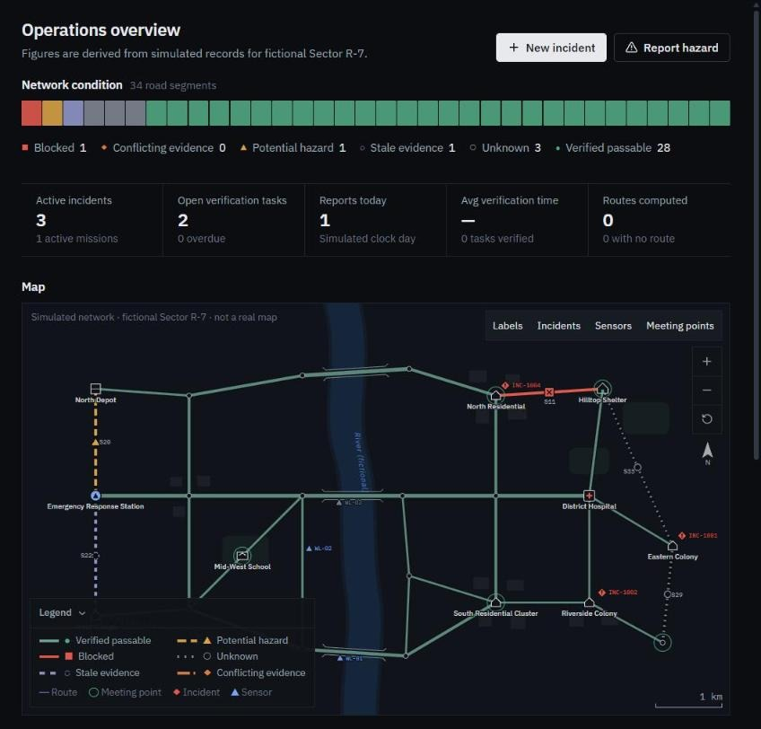
TECHNICAL APPROACH
[Team Name]
❖ Technologies to be used (e.g. programming languages, frameworks, hardware)
Frontend: React 18 + TypeScript, Vite, Tailwind CSS (responsive, keyboard-accessible)
Map: Custom SVG road-network renderer; no paid map or API keys
Routing: Dijkstra graph engine in TypeScript: 3 modes, alternatives, last-mile
Evidence: Rule engine: freshness, trust tiers, duplicates, conflicts
Data: LocalStorage persistence, Service Worker offline cache, CSV export
Quality: Vitest: 34 automated tests, 27 evaluation cases, 8 demo scenarios
Hardware (opt.): ESP32 + water-level sensor sending {sensorId, valueCm, ts} over Wi-Fi
Working prototype: operations dashboard (simulated data)
❖ Methodology and process for implementation (Flow Charts/Images/ working prototype)
Inputs
Crowd reports, field inspections, sensor readings
Evidence engine
Freshness · trust tier · duplicates · conflicts
Road status
6 statuses + “Why this status?” explanation
Routing
Fastest · Evidence-prioritized · Conservative
Decision output
Route + alternatives, or “no verified route” + meeting point
Field verification
Verifier confirms; result updates graph and reroutes
SEVA FIRST INNOVATION CHALLENGE 2026

Slide 4
FEASIBILITY AND VIABILITY
[Team Name]
❖ Analysis of the feasibility of the idea
Potential challenges and risks | Strategies for overcoming these challenges
False or prank crowd reports | Trust tiers; anonymous reports stay unverified; duplicate detection; verification tasks
Outdated information | Hazard-specific expiry; stale roads flagged and queued for re-inspection
Network loss during disasters | Offline-first: reports queued, synced later with conflict detection
Over-reliance on automation | Decision support only; human confirmation; never labels a route “safe”
Sensor faults or misreadings | A sensor alone never marks a road passable; out-of-range and disconnect alerts
Real road data & approvals | Pilot with local authority GIS / OpenStreetMap data under formal permission
Working
prototype built and demonstrable today
₹0
software licences, API keys or paid maps
~₹2,600
per optional sensor node (estimate*)
27/27
evaluation cases pass in the test suite
Runs offline on an ordinary laptop; open-source stack; one-click Windows launcher.
*Indicative component estimates; require supplier verification.
SEVA FIRST INNOVATION CHALLENGE 2026

Slide 5
IMPACT AND BENEFITS
[Team Name]
❖ Potential impact on the target audience
Measured in the prototype vs. a plain shortest-path baseline
District Emergency Operation Centres and control rooms
Ambulance, fire and rescue crews (SDRF / NDRF teams)
Local authorities and ward offices verifying roads
Residents of flood- and landslide-prone areas
4 → 0
7 → 0
8 / 8
confirmed-blocked road segments routed through
unverified segments on chosen routes
end-to-end demo scenarios pass
11 routing test cases on simulated data; not field validation.
❖ Benefits of the solution (social, economic, environmental, etc.)
Social
Fewer rescue vehicles sent into blocked or flooded roads; faster verified access to people in need
Economic
Zero licence cost; runs on existing laptops and phones; low-cost optional sensors
Environmental
Fewer wasted detours and idle trips; reusable flood-level data for planning
Governance
Every decision explainable and logged; supports accountable, auditable response
SEVA FIRST INNOVATION CHALLENGE 2026

Slide 6
RESEARCH AND REFERENCES
[Team Name]
❖ Details / Links of the reference and research work
Research basis for the design
References
1. NDMA, National Disaster Management Plan (2019) https://ndma.gov.in
2. NDMA, Guidelines on Management of Urban Flooding (2010) https://ndma.gov.in
3. UNDRR, Sendai Framework for Disaster Risk Reduction 2015–2030 https://www.undrr.org
4. Central Water Commission, flood forecasting services https://cwc.gov.in
5. Dijkstra, E. W. (1959). A note on two problems in connexion with graphs. Numerische Mathematik 1, 269–271
6. Humanitarian OpenStreetMap Team, open map data for disaster response https://www.hotosm.org
7. [Add any other papers / articles the team consulted]
Prototype
Source code: [GitHub repository URL]
Demo video: [Demo video URL]
Consumer navigation optimises travel time from traffic data; it does not certify that a road is physically passable during floods or landslides
Disaster reports are often crowd-sourced, unverified and quickly outdated, so evidence needs freshness and trust levels
Emergency decisions must be explainable and auditable, so we use transparent rules, not black-box scores
Connectivity degrades in disasters, so the system has to work offline first
SEVA FIRST INNOVATION CHALLENGE 2026

